Slide 1
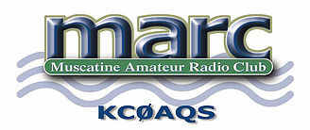
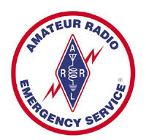
Introduction to Amateur Radio
April, 2017
Presented by:
MARC ~ Muscatine Amateur Radio Club ~ www.MuscatineARC.org
Muscatine County Amateur Radio Emergency Service ~ www.MuscatineARES.org

Slide 2
Syllabus
1. What is Amateur Radio?
2. What Hams do with Amateur Radio
3. How to Become a Radio Amateur
4. Your First Station
5. Why Join a Local Club?

Slide 3
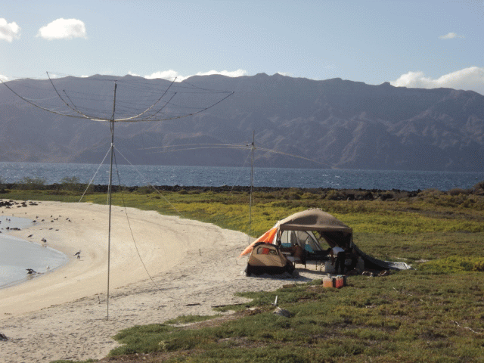
What is Amateur Radio?
Amateur Radio is a community of people who use radio transmitters and receivers to communicate with other Amateur Radio operators.

Slide 4
Communicate, Experiment, Interact, Compete
Amateur radio is a regulated, non-commercial radio service. Unlike other radio services, such as CB or GMRS, hams can transmit with as much as1500 watts PEP.
Experimentation is not only allowed, but it’s encouraged. Ham radio is truly a hobby, but often one that makes a difference especially in emergency or disaster situations. It is an activity of Self-Learning, Inter-Communication, and Technical Investigation.
Amateurs talk to local friends over the radio waves using hand-held transceivers, communicate digitally using packet, to exchange personal messages, or vital information in an emergency, talk to other hams anywhere in the world, or engage in contests over the airwaves.
There is truly something for everyone. In the U.S. there are over 700,000 licensed radio amateurs, and this number is steadily increasing.

Slide 5
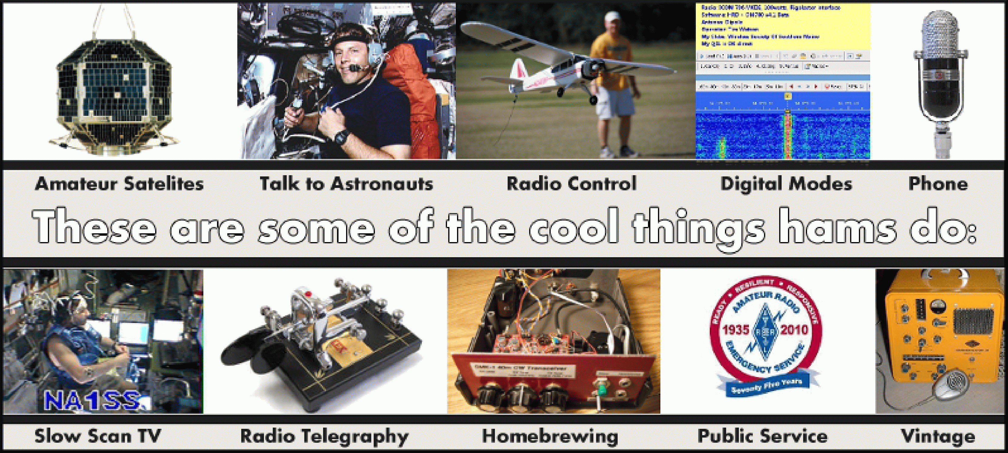
What Do Hams Do?
QRP HF VHF Dxing Emcomm Technical Contesting Satellites Digital SSTV
Space Communications

Slide 6
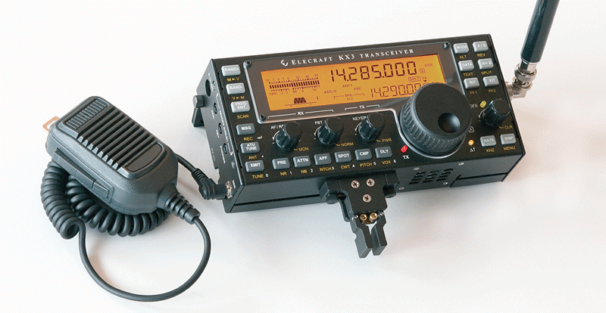
QRP
Communicating with ‘very low power’ is a challenge that many hams enjoy. QRP is usually practiced on the HF bands.

Slide 7
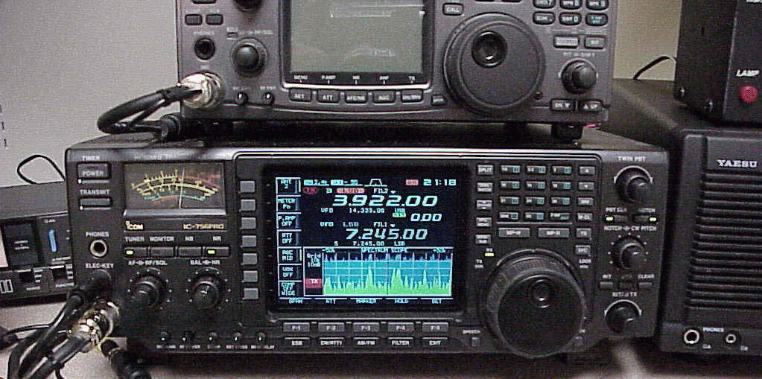
HF Radio
Hams can talk to other hams in literally any part of the world using the ‘short waves.’
By bouncing signals off the ionosphere, signals can travel 1000's of miles.

Slide 8
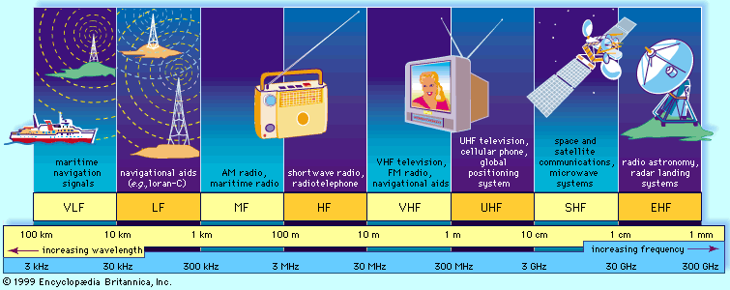
The Radio Spectrum
Radio Amateurs have privileges from 160 meters (MF) to the Microwave bands (SHF)

Slide 9
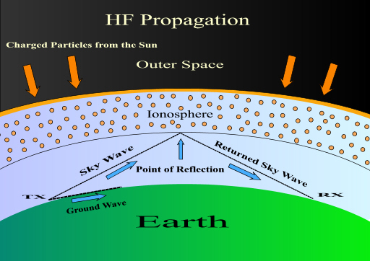
HF Propagation

Slide 10
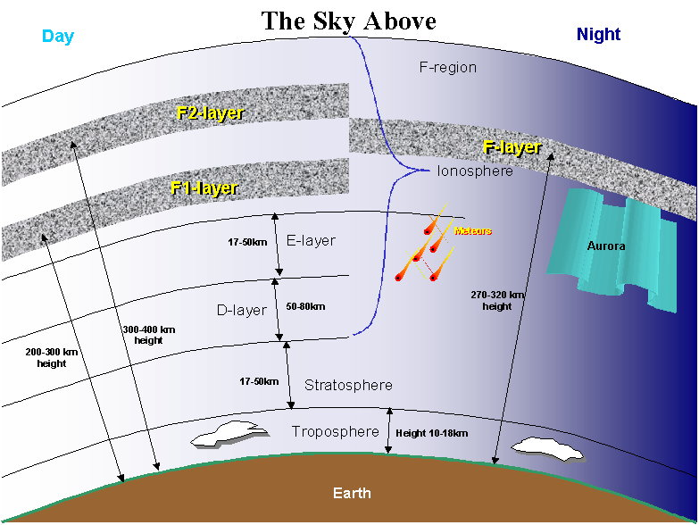
Layers of the Ionosphere

Slide 11
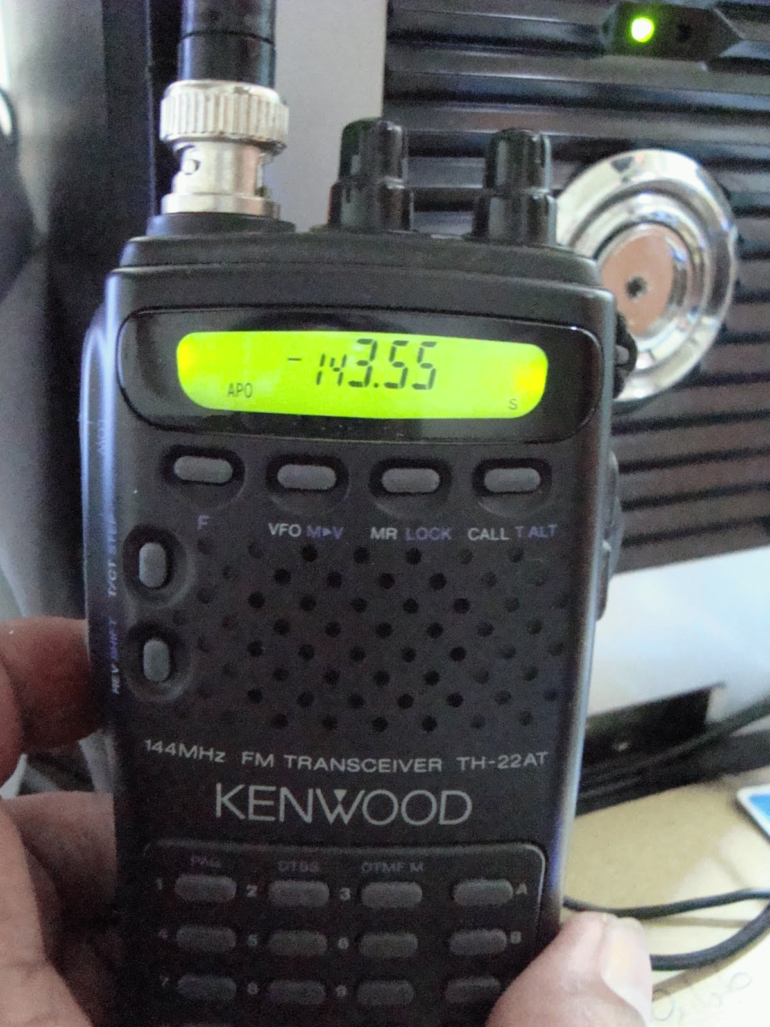
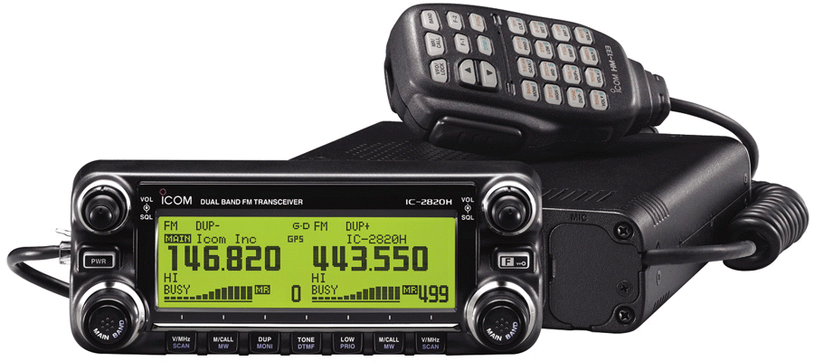
VHF & UHF
Hams enjoy extremely reliable communications within their local community via simplex communications, or make use of repeaters that can extend the range up to 50 miles or more.
Single-band handheld transceiver (right)
Typical dual-band mobile transceiver (below)

Slide 12
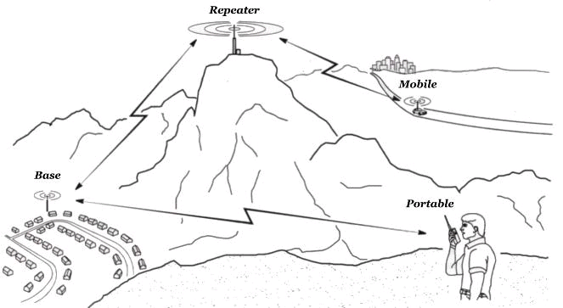
Repeater vs. Simplex Communication
Repeaters help extend the range of VHF and UHF handheld and mobile transceivers.

Slide 13
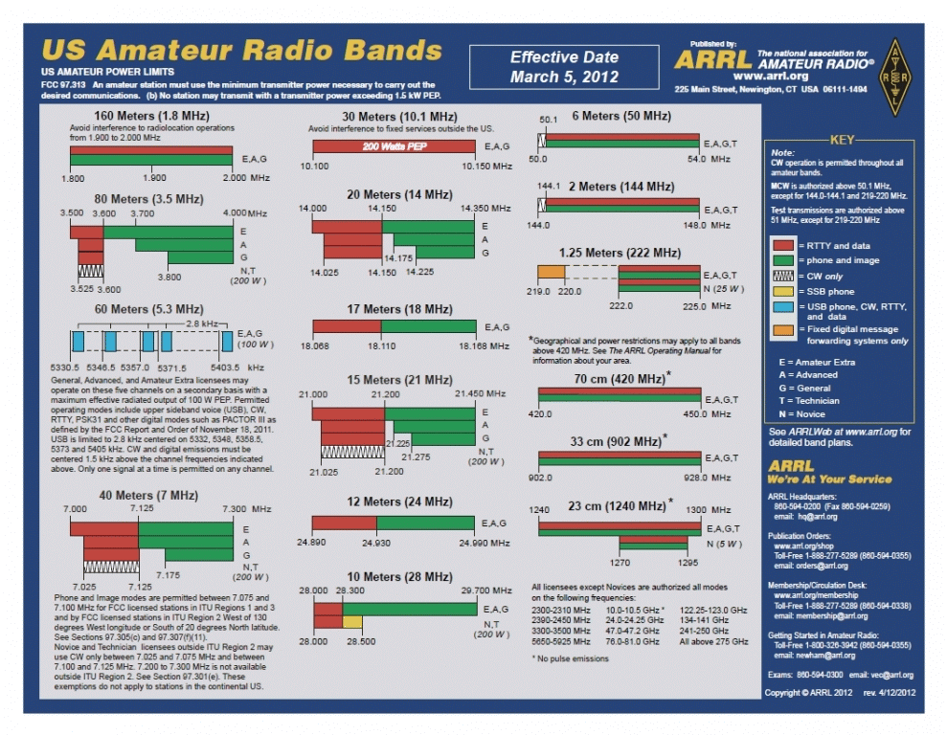

Slide 14
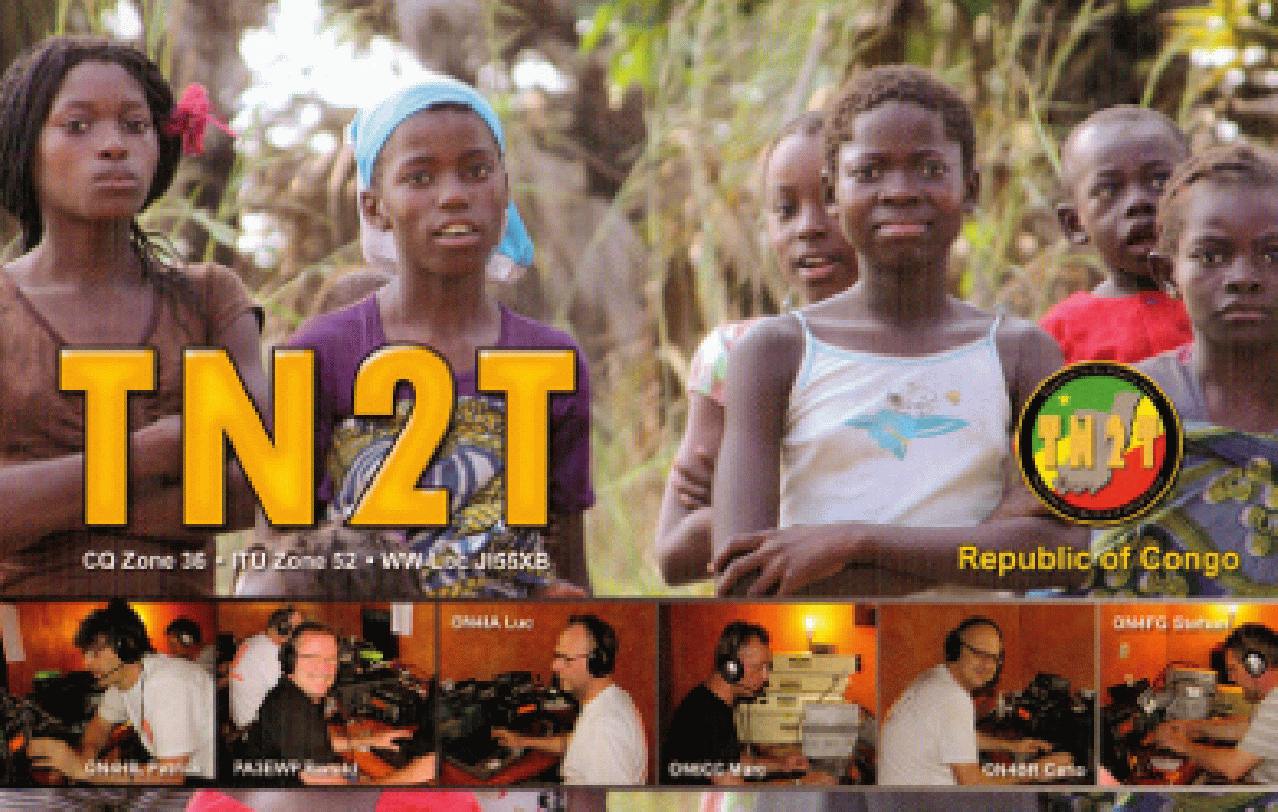

Dxing
DX means distance communication, and with the right equipment, worldwide communication on the HF bands (10 through 160 meters) is a regular possibility.
Many DXers like to contact stations on rare islands and countries which aren’t frequently present on the airwaves. This is sometimes called ‘chasing DX’

Slide 15
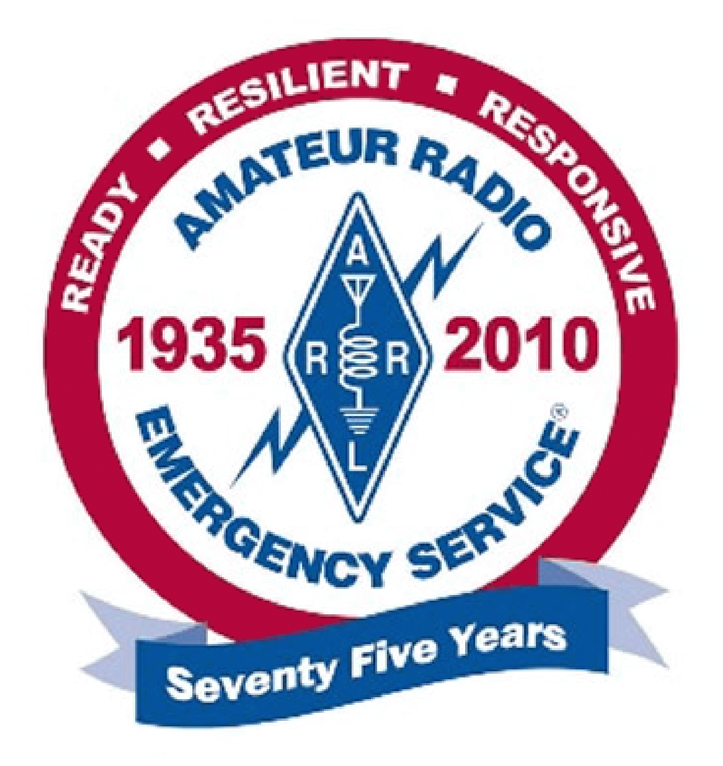
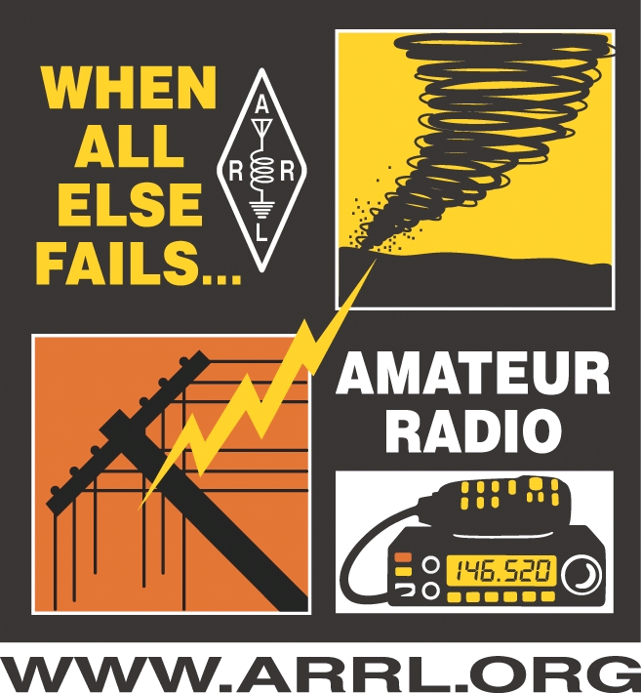
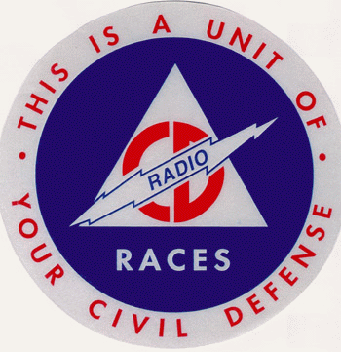
Emergency and Other Volunteer Services
Floods, landslides, earthquakes, hurricanes, accidents (Rail / Road / Air), etc.
Whenever regular communications fail, hams are ready to use their radios to provide emergency communication services to their communities.

Slide 16
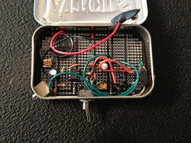
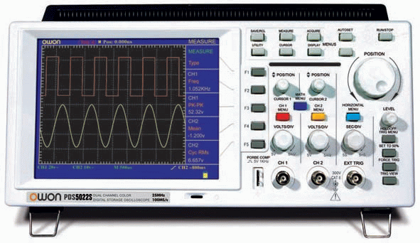
Technical Experimenting & Kit Building
Hams come from all walks of life, ranging from technicians to engineers, teachers to scientists, and students to retirees. For many of them, the attraction to the hobby is to build their own equipment whether it is just a simple antenna, something as complex as a transmitter, or an interface between their radio and a computer.

Slide 17
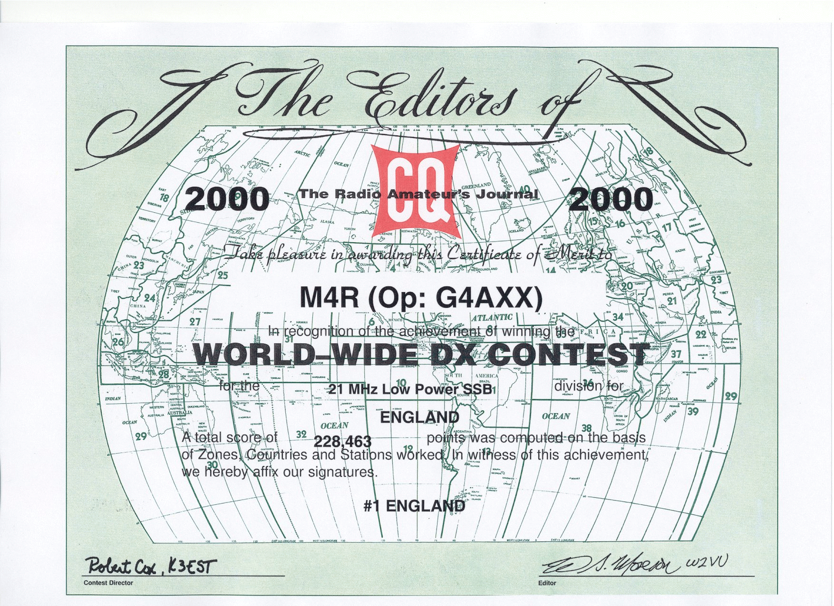
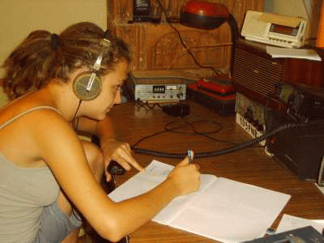
Contesting
Contesting is often called the ‘sport’ of ham radio. Almost every weekend there is some form of amateur radio contest. Hams get on the air and compete to see who can make the most contacts in a limited period of time.
You can put your radio skills up against other hams and teams of hams.

Slide 18
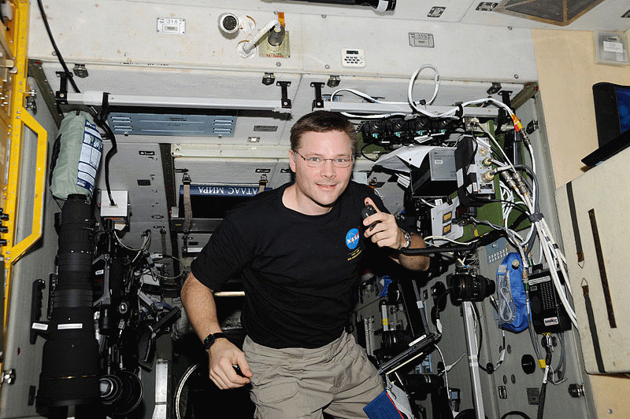
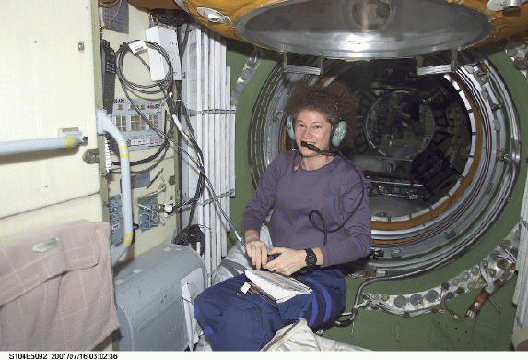
Talk to Astronauts
Yes, it is really possible. Space stations do have ham radio equipment and licensed ham astronauts often take the time to make contacts with amateurs on earth. Hams also can use satellites as ‘repeaters in the sky’ to make contacts with other earth stations over great distances.

Slide 19
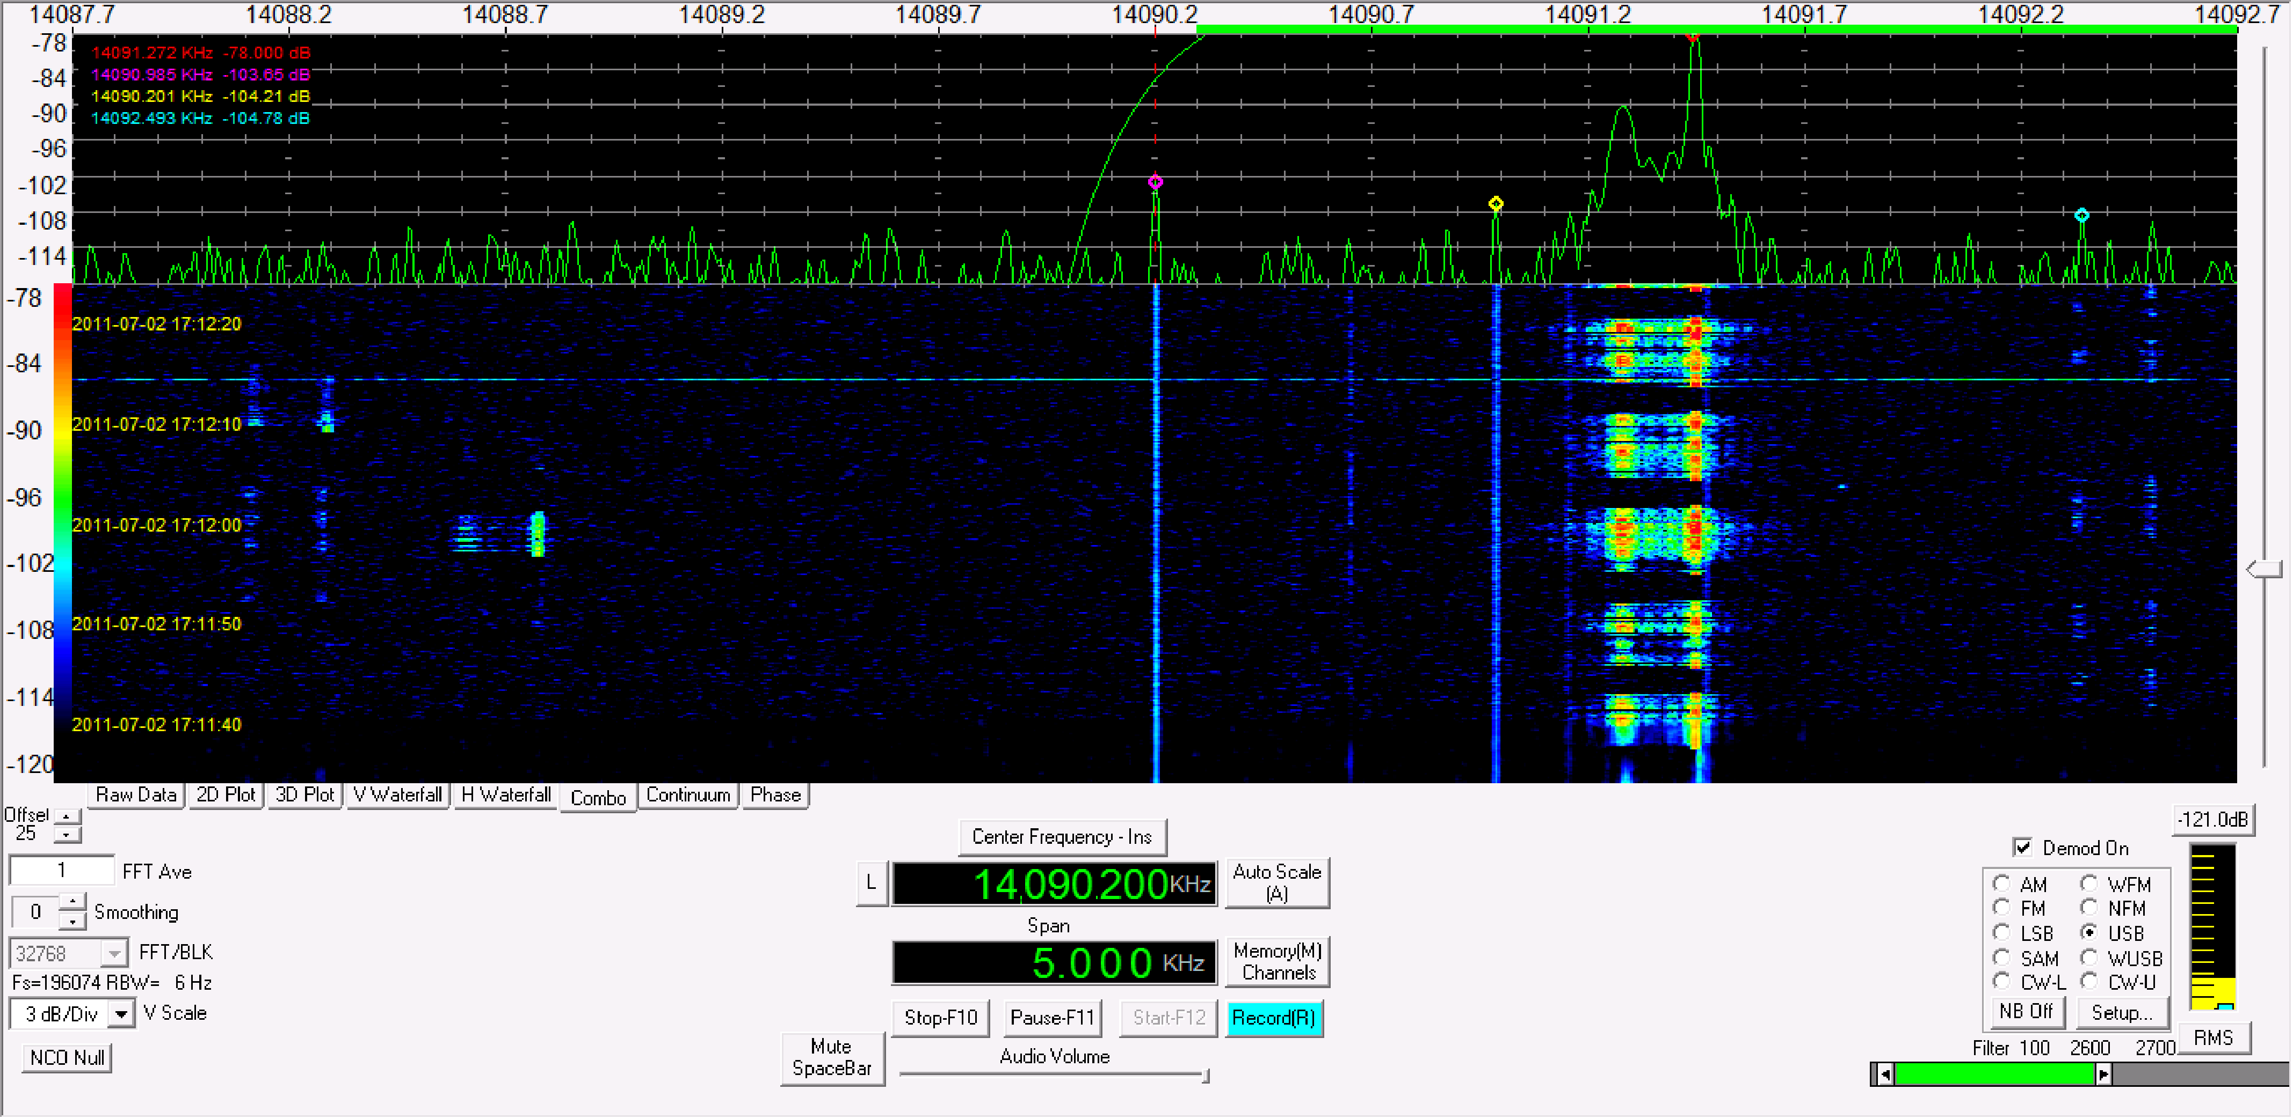
Digital Communication
Connect a computer to your radio and install some software and you can be communicating digitally over the air. Some of these digital modes can be more effective in marginal transmission conditions and some even sport error free transmission, using methods of Forward Error Correction.

Slide 20
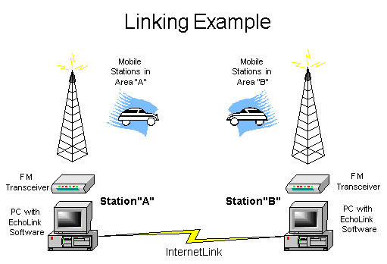
Internet Communication
Using some of the latest technologies, hams can supplement a modest station with Internet connections. Using features such as D-STAR, Echolink, or IRLP on a local repeater, a ham in Maine can talk to one in Vancouver or even Australia using a simple hand-held transceiver.

Slide 21
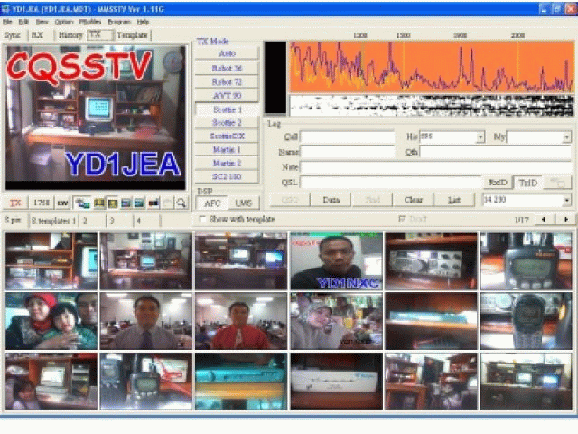
Slow Scan Television
Using a PC with specialized software, you can send pictures around the world.

Slide 22
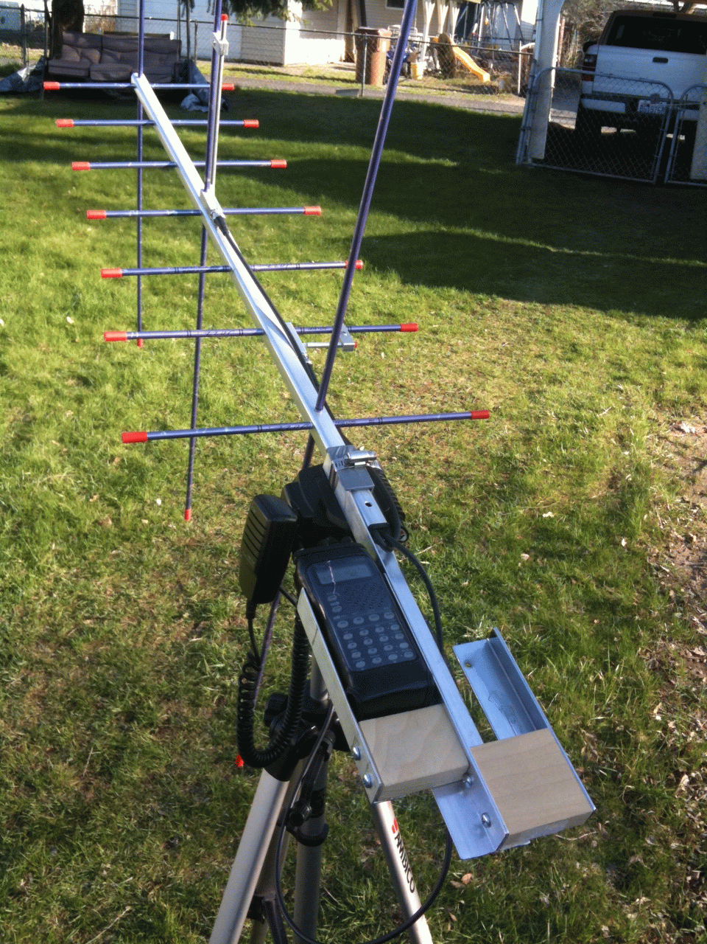
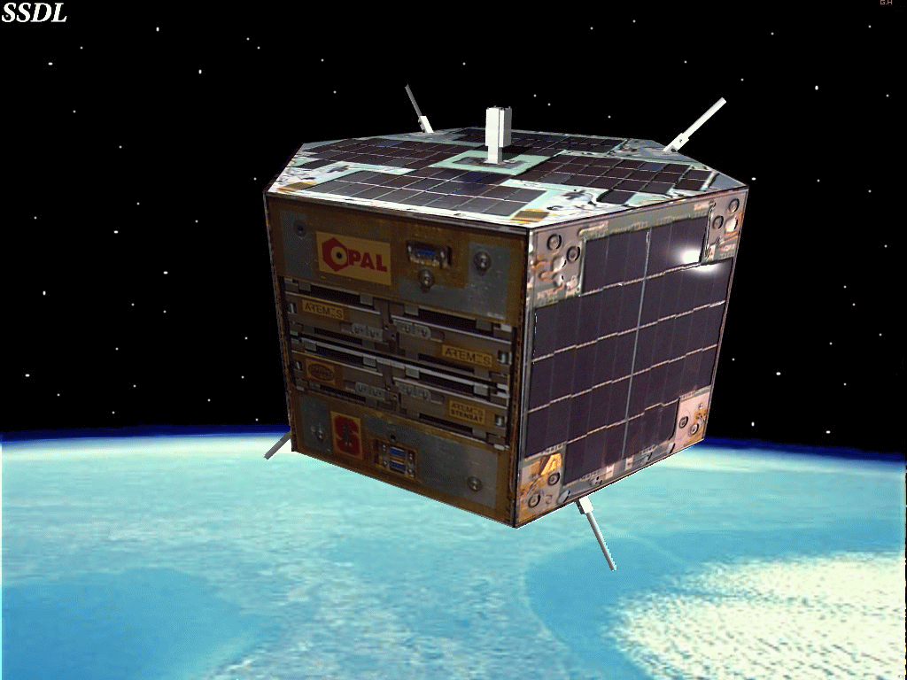
Satellite Communications
Amateur Radio satellites use specially allocated frequencies to facilitate communication between amateur radio stations.
These satellites can be used for free by licensed amateur radio operators for voice and data communications. Currently, satellites in orbit act as repeaters, linear transponders, or store and forward digital relays.

Slide 23
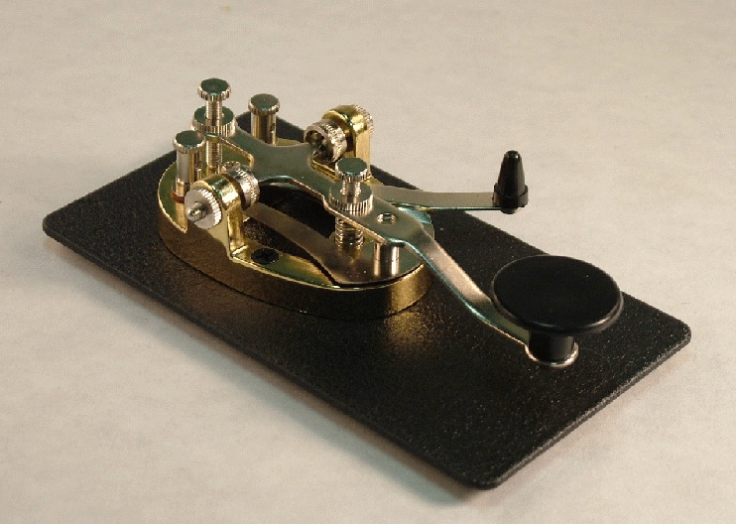
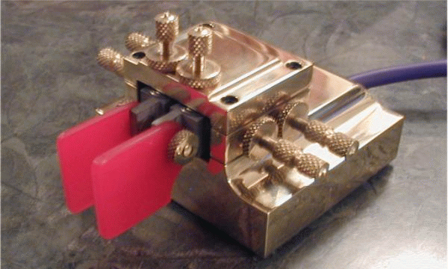
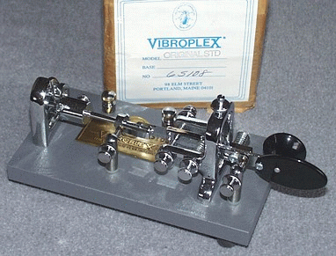
Morse Code (CW)
Morse Code is the original digital mode. It’s a method of transmitting text as a series of on-off tones that can be directly understood by a skilled listener. The code consists of sequences of short and long signals called ‘dits’ and ‘dahs’ which represent all 26 Roman letters, as well as numbers, punctuation, and prosigns.
Though no longer required for licensing in most countries, “CW” or continuous wave is still a popular operating mode among amateur radio operators today. Many consider it to be the language of ham radio.

Slide 24
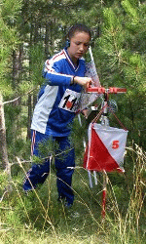
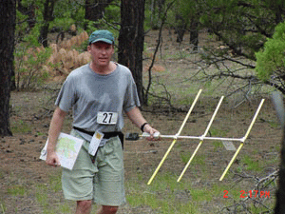
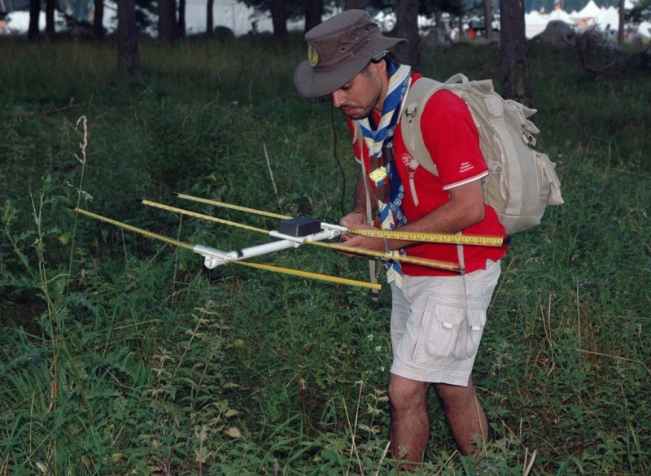
Amateur Radio Direction Finding (ARDF)
Radio Direction Finding has many purposes, both practical and fun. It can be used to track down interference, assist in search and rescue, find hidden transmitters in a fox hunt, or even track animals that have been equipped with radio transmitting devices.
In some places, ARDF competitions are organized, which awards those who can locate hidden transmitters the fastest. This specialized skill combines knowledge of radio signals and orienteering.

Slide 25
How to Become a Radio Amateur
The government regulatory agency that issues Amateur Radio licenses in the United States is the FCC.
To earn your initial license, you must pass a 35 question multiple choice examination that covers topics such as:
Radio and Electronic Fundamentals
Operating Station Equipment
How to Communicate with Other Hams
Licensing Regulations
Operating Regulations
Electrical and RF Safety

Slide 26
License Classes
In the United States there are three license classes currently available. Each one builds upon the previous and offers more privileges.
Technician - Your first Amateur Radio license offers privileges on portions of the 10 meter band, as well as 6 meters, VHF, UHF, and the microwaves. The intent of the exam is to affirm understanding of rules, station components, basic electronics, and how to operate in accordance with good engineering and amateur practice.
General - The General Class offers many more privileges in the HF bands, which allow for regular international communications on the short wave frequencies (between 160-10m). The exam takes a closer look at frequency allocations and added focus on technical proficiency.
Extra - This is the highest level Amateur Radio license currently offered in the U.S. It offers extra portions of the HF bands and has an extensive focus on radio theory, advanced electronics, operating modes, radio wave propagation, etc.

Slide 27


All tests in the U.S. are administered by Volunteer Examiners
Once licensed, you will be issued a call sign:
All Amateur Radio call signs are made up of a prefix and a suffix.
Maine is located in the W1 call district within the U.S.

Slide 28
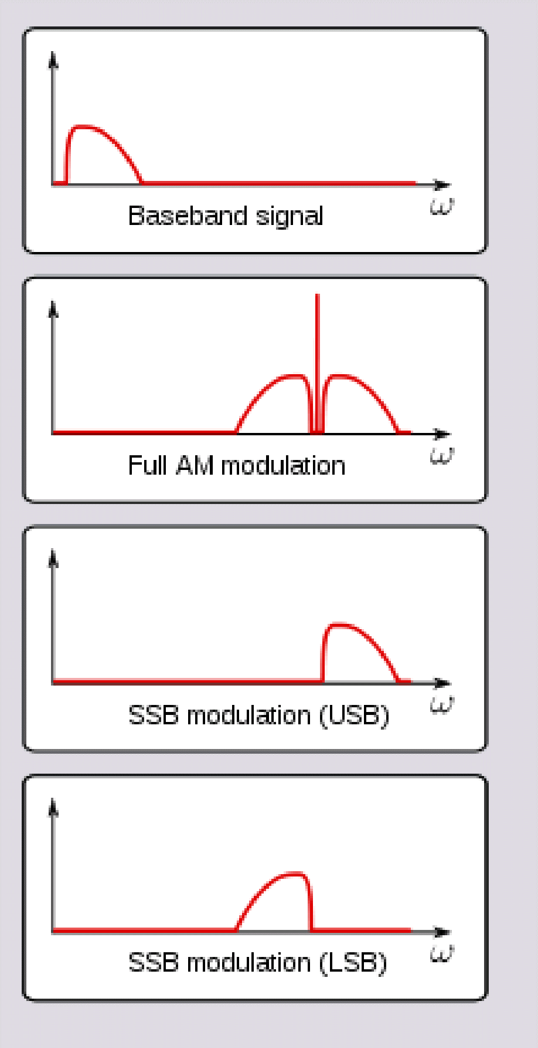
Modes of Communication
Continuous Wave (CW) - A wave of constant amplitude and frequency. Morse code is transmitted by this means when a carrier wave is switched on and off.
Amplitude Modulation (AM) - AM works by varying the strength of the transmitted signal in relation to information being sent. Power is concentrated on the carrier frequency and two adjacent sidebands.
Single Sideband (SSB) - A refinement of Amplitude Modulation, that more efficiently uses transmitter power and bandwidth by suppressing the carrier and concentrating power to a single sideband. SSB has become the standard for long distance voice communications.

Slide 29
Modes of Communication (cont’d)
Frequency Modulation (FM) - Frequency modulation conveys information over a carrier wave by varying its instantaneous frequency. This is the popular mode of voice communication in the VHF and UHF amateur bands, as well as most utility and public service radios. Wide (bandwidth) FM is the standard for commercial broadcasters in the North American 88-108 MHz band.
Frequency Shift Keying (FSK) - a frequency modulation scheme in which digital information is transmitted through discrete frequency changes of a carrier wave. The simplest form uses a pair of discrete frequencies to transmit binary (0s and 1s) information. An example would be the digital mode, MFSK-16
Phase Shift Keying (PSK) - a digital modulation scheme that conveys data by changing or modifying the phase of a carrier wave. An example would be the popular digital mode, PSK-31.

Slide 30
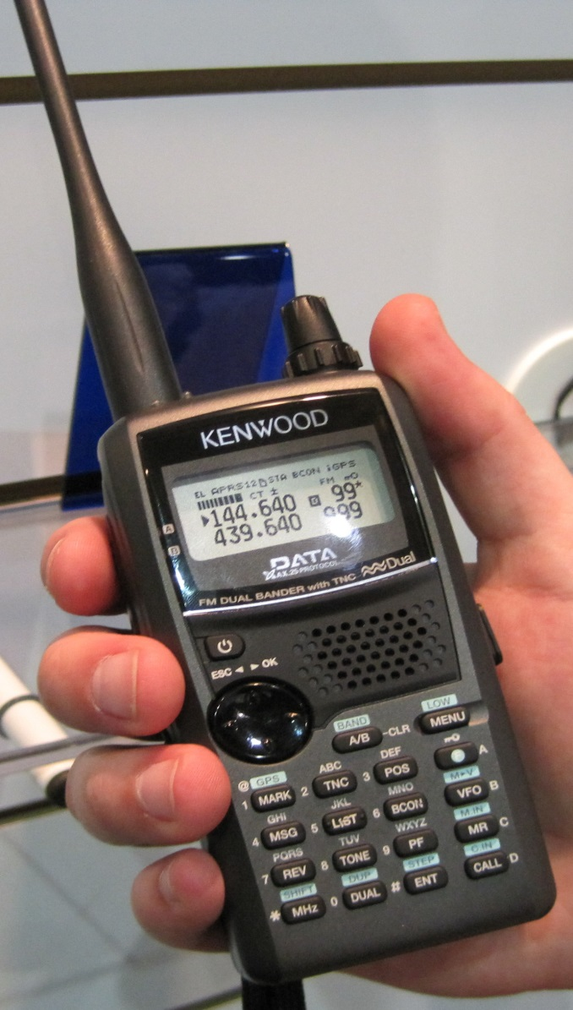
What do I need to get on the air?
To get started, all you need is a hand-held transceiver. These come in several varieties and cost as little as $59. Most common are single band 2 meter or 70 cm transceivers, or dual band. Some high end models may include additional bands such as 6 meters (50 MHz), 1.25 meters (220 MHz), or even 33 cm, (902 MHz).
Some of these “handy-talkies” are capable of APRS operation, and include built in TNC’s and GPS units. Others include digital voice and messaging capabilities for use with the D-STAR network.

Slide 31
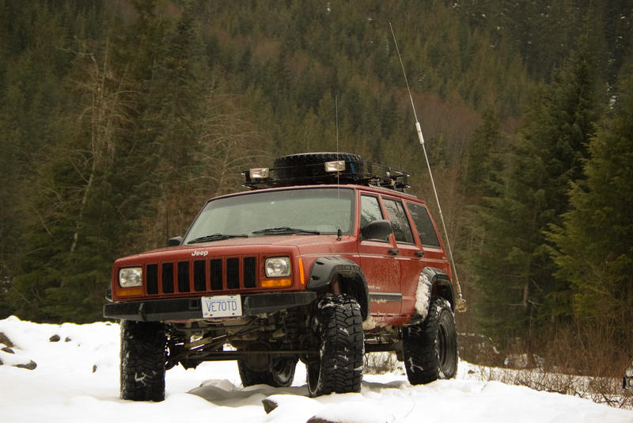
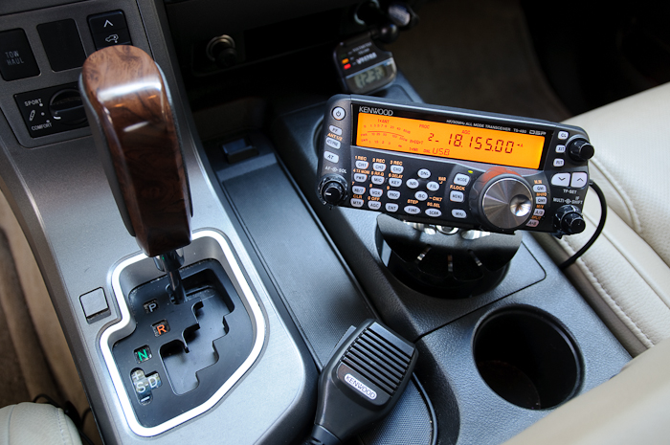
Going Mobile
Operating while mobile is one of the most popular ways hams communicate. A typical mobile setup includes a 50W VHF / UHF transceiver connected to a vertical mag-mount antenna.
Some take it to the extreme, however, and install a full fledged mobile setup, including multi-band antennas and even tuners.

Slide 32
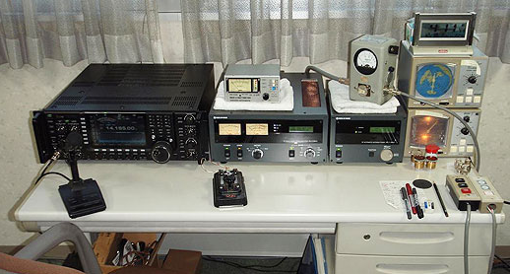
Base Station
A typical base station for HF consists of a power supply, transceiver, antenna tuner, amplifier, and if you choose to use digital modes, a PC interface. A variety of antennas can be used, and these depend on band, available space, and preference.

Slide 33
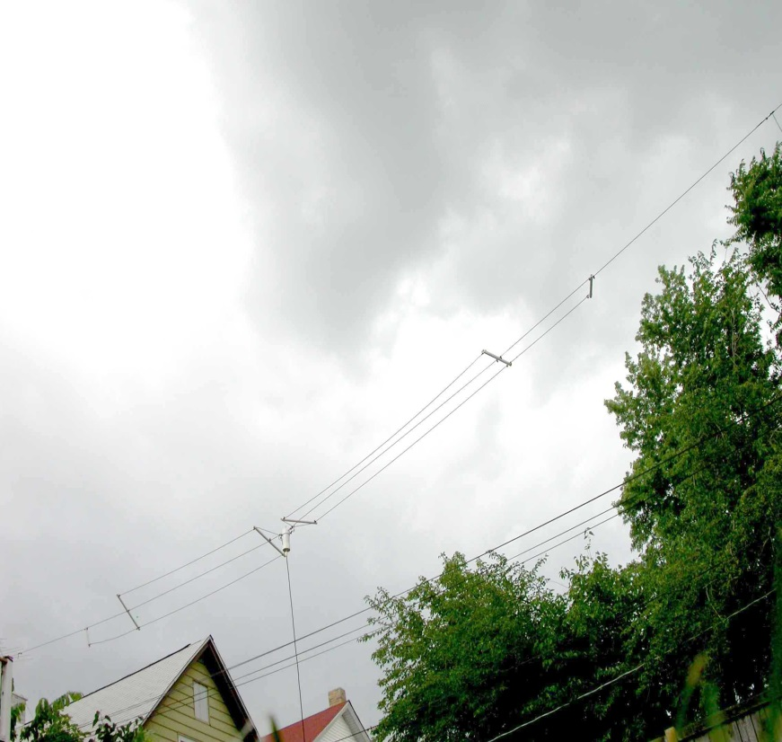
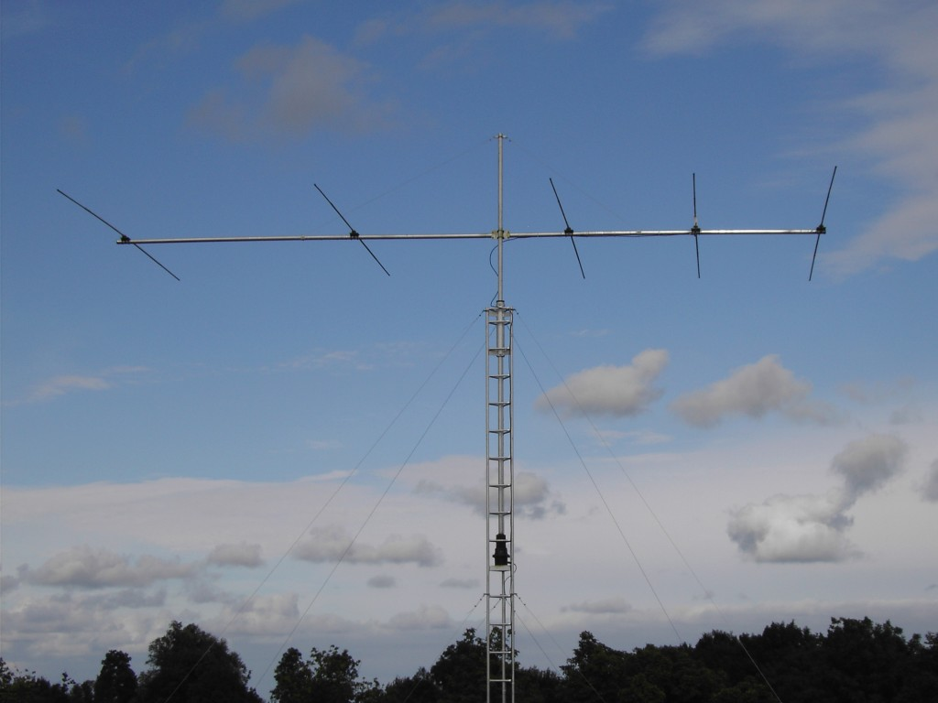
Antennas
Wire Dipole HF Yagi

Slide 34
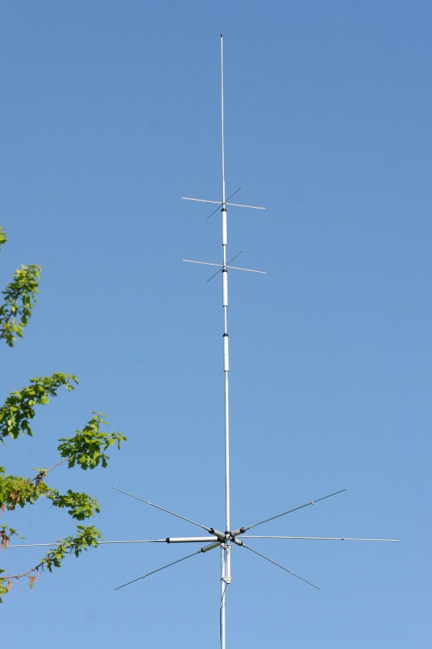
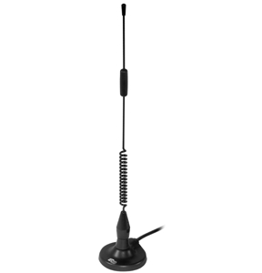
(left) Multi-band HF Vertical
(top) VHF Mobile Antenna

Slide 35
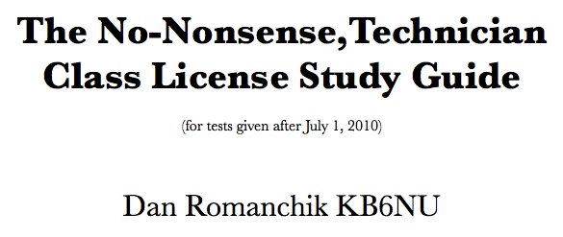
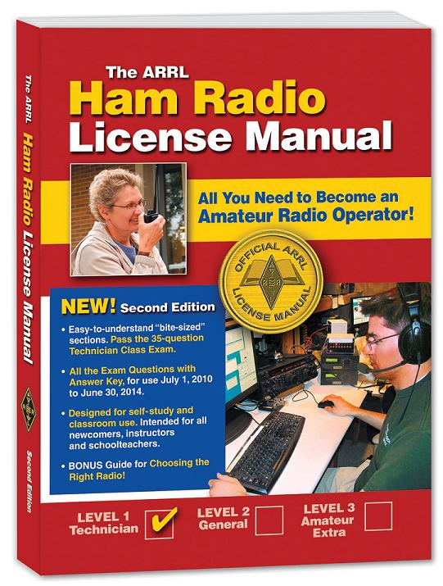
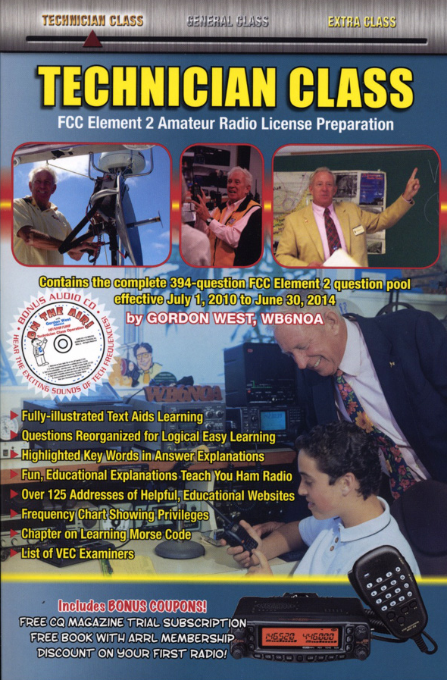
Resources

Slide 36
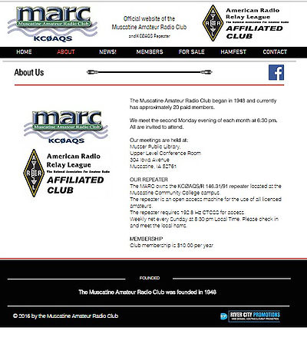
Why Join a Local Club?
Friendship
Camaraderie
Technical Expertise
Events & Activities
Education
Public Service
Competitions

Slide 37
